Slide 1
Estimators and Sampling
Justin M. Rao, MSR-NYC

Slide 2
Outline
Basics of estimation
Samples vs. populations
Sampling theory, IID assumptions and departures
Regression: linear and non-parametric

Slide 3
Population vs. samples
Population: every object in a specified set
Set must be well-defined.
Ex. Americans, all internet users, all lab rats with lymphoma, all high school students, etc.
Sample: a subset of the population selected in some way

Slide 4
Ex. Population vs. samples
Population: heights of all US-located men age 18-65
Some samples:
Heights of the DS3 instructors
Heights of all men in this room
Heights of people we stop on 6th ave.
How do these samples differ from the population?

Slide 5
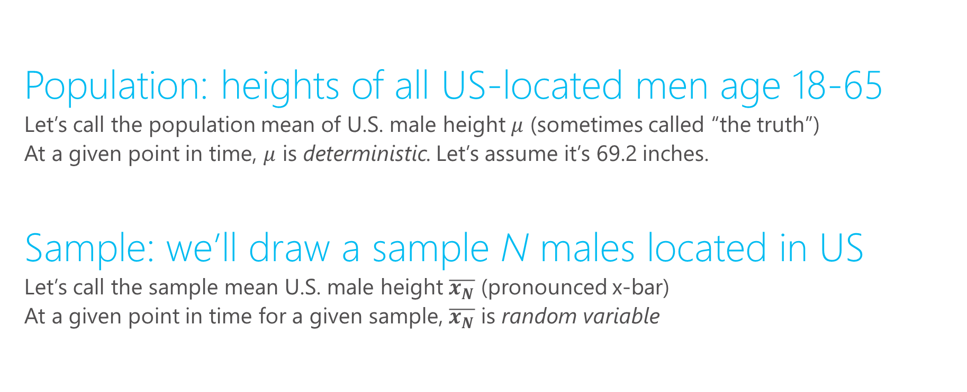
Population mean vs. sample mean
Population: heights of all US-located men age 18-65
Let’s call the population mean of U.S. male height $μ$ (sometimes called “the truth”)
At a given point in time, $μ$ is deterministic. Let’s assume it’s 69.2 inches.
Sample: we’ll draw a sample N males located in US
Let’s call the sample mean U.S. male height $\overline{x_{N}}$ (pronounced x-bar)
At a given point in time for a given sample, $\overline{x_{N}}$ is random variable

Slide 6
What is a “random variable”
Deterministic: not influenced by chance
In measurement: every time you measure, you get the same answer.
In models: for same input, you always get same output
Stochastic: there is some element of randomness
In measurement: every time you “measure”, you expect a different outcome
In models: the same input leads to different output
In both cases: you cannot perfectly predict what will happen

Slide 7
Examples:
Which of the following are deterministic vs. stochastic
“Baseball model”: inputs certain pitcher facing certain batter
Subway measurement: trip time between Station X and Station Y
Weight of a quarter
Length of a day

Slide 8
$\overline{x_{N}}$ as a random variable
Determine sample size, N
Determine sampling procedure
How are we going to get N observations?
Provided N is not equal to the population, then each sample will tend to differ. Imagine we sample twice:
All statistics we measure will tend to differ between the two samples
Statistical theory will tell us the degree to which we should expect them to differ

Slide 9
$\overline{x}$ is an estimator for $μ$
Samples are used to estimate population parameters
Statistical properties of how the sample is drawn will determine how useful the estimator is
Observe heights in the sample to make inference about heights in the population

Slide 10
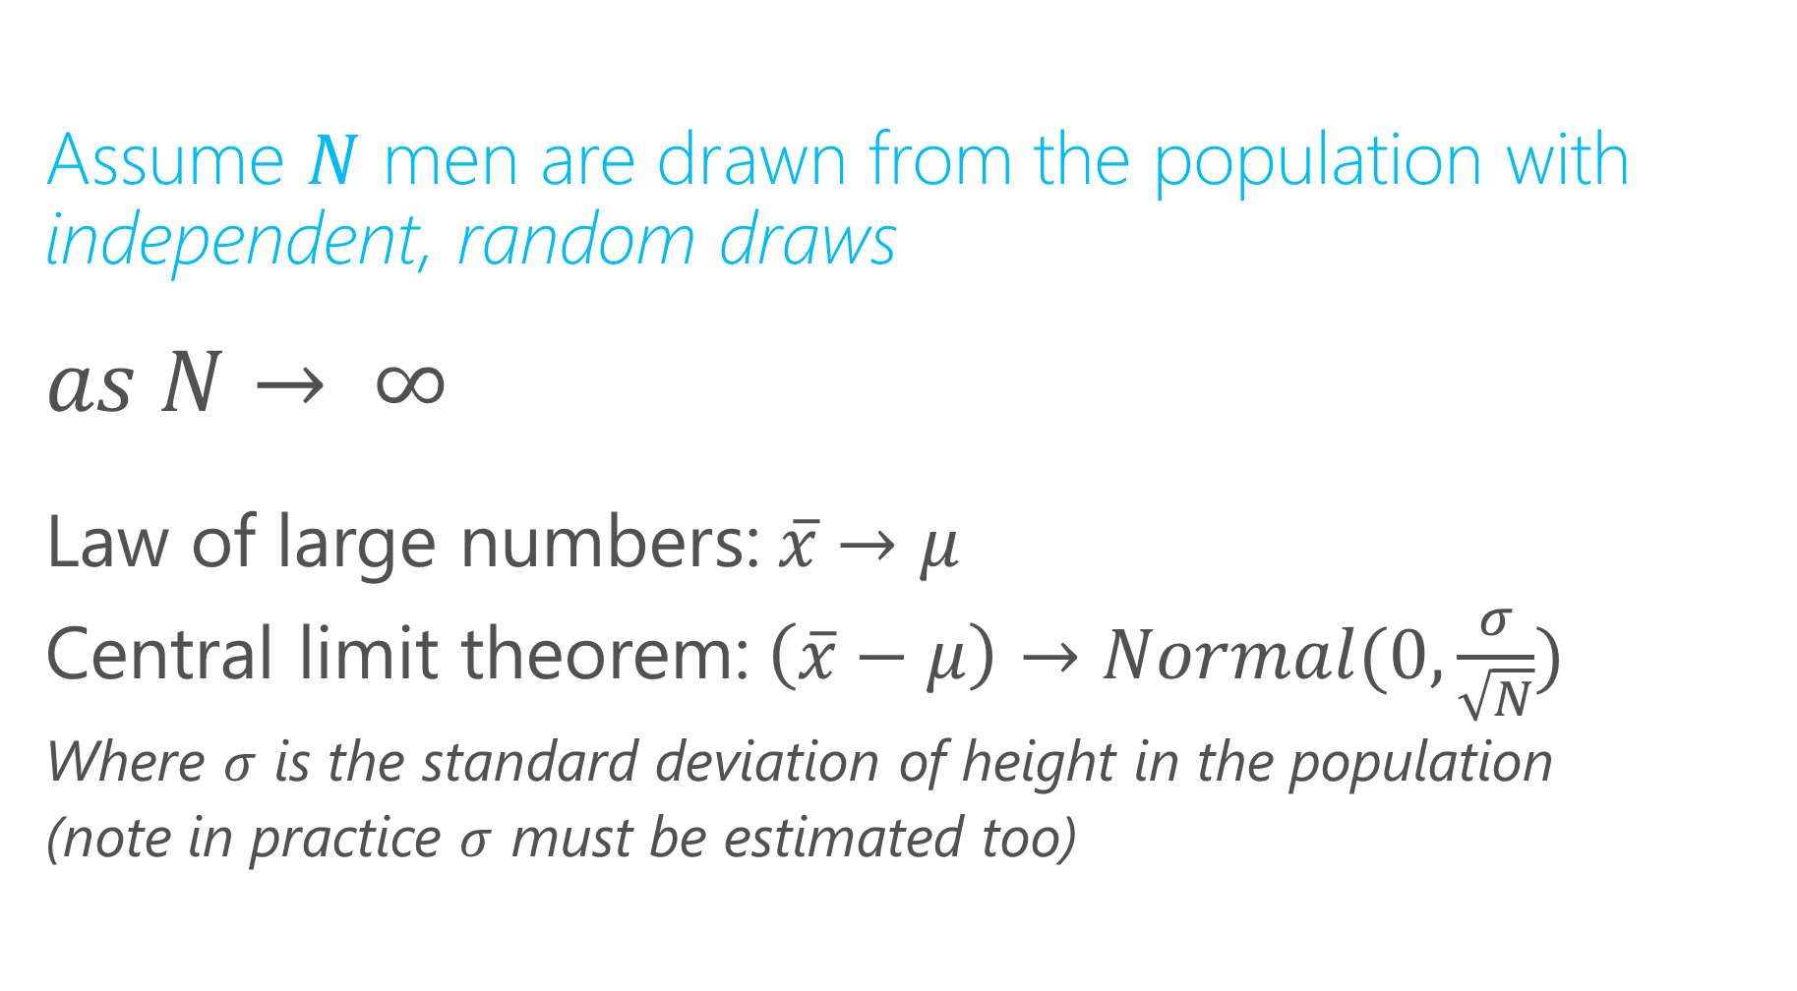
Properties of the sample mean
Assume $N$ men are drawn from the population with independent, random draws
$$as N→ ∞$$
Law of large numbers:$x̅→μ$
Central limit theorem:$\left(\overline{x}−μ\right)→Normal(0,\frac{σ}{\sqrt{N}})$
Where $σ$ is the standard deviation of height in the population
(note in practice $σ$ must be estimated too)

Slide 11
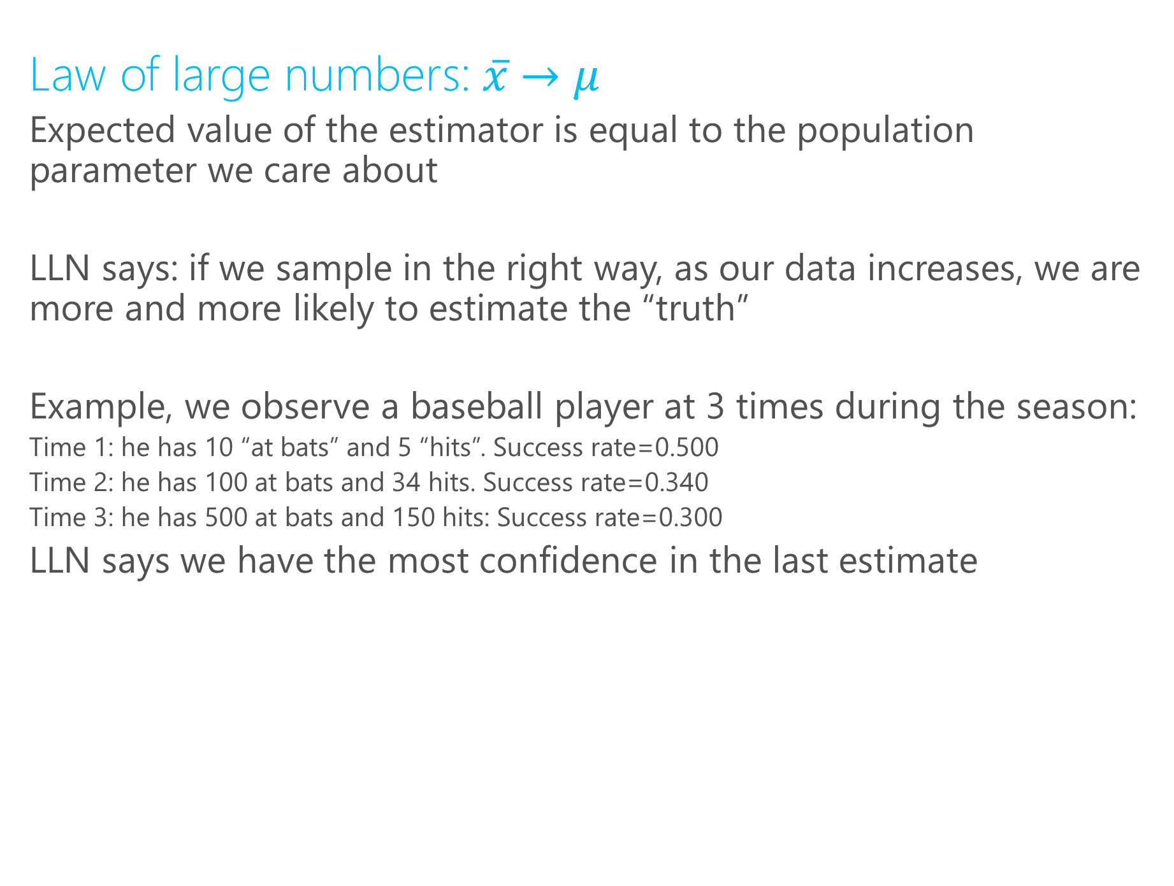
Properties of the sample mean
Law of large numbers:$x̅→μ$
Expected value of the estimator is equal to the population parameter we care about
LLN says: if we sample in the right way, as our data increases, we are more and more likely to estimate the “truth”
Example, we observe a baseball player at 3 times during the season:
Time 1: he has 10 “at bats” and 5 “hits”. Success rate=0.500
Time 2: he has 100 at bats and 34 hits. Success rate=0.340
Time 3: he has 500 at bats and 150 hits: Success rate=0.300
LLN says we have the most confidence in the last estimate

Slide 12
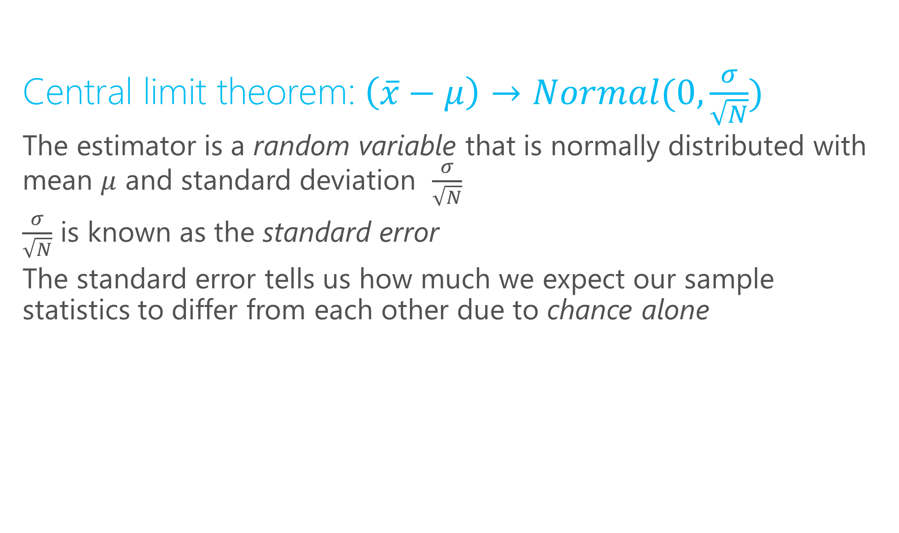
Properties of the sample mean
Central limit theorem:$\left(\overline{x}−μ\right)→Normal(0,\frac{σ}{\sqrt{N}})$
The estimator is a random variable that is normally distributed with mean $μ$ and standard deviation $\frac{σ}{\sqrt{N}}$
$\frac{σ}{\sqrt{N}}$ is known as the standard error
The standard error tells us how much we expect our sample statistics to differ from each other due to chance alone

Slide 13

Standard error vs. standard deviation
Standard deviation measures the dispersion in the underlying population
$$\sqrt{E{\left(X−μ\right)}^{2}}=σ$$
Are far are data points from the population mean on average?
Ex. standard deviation of income tells us how different we expect a randomly selected to person’s income to be from the overall mean.

Slide 14

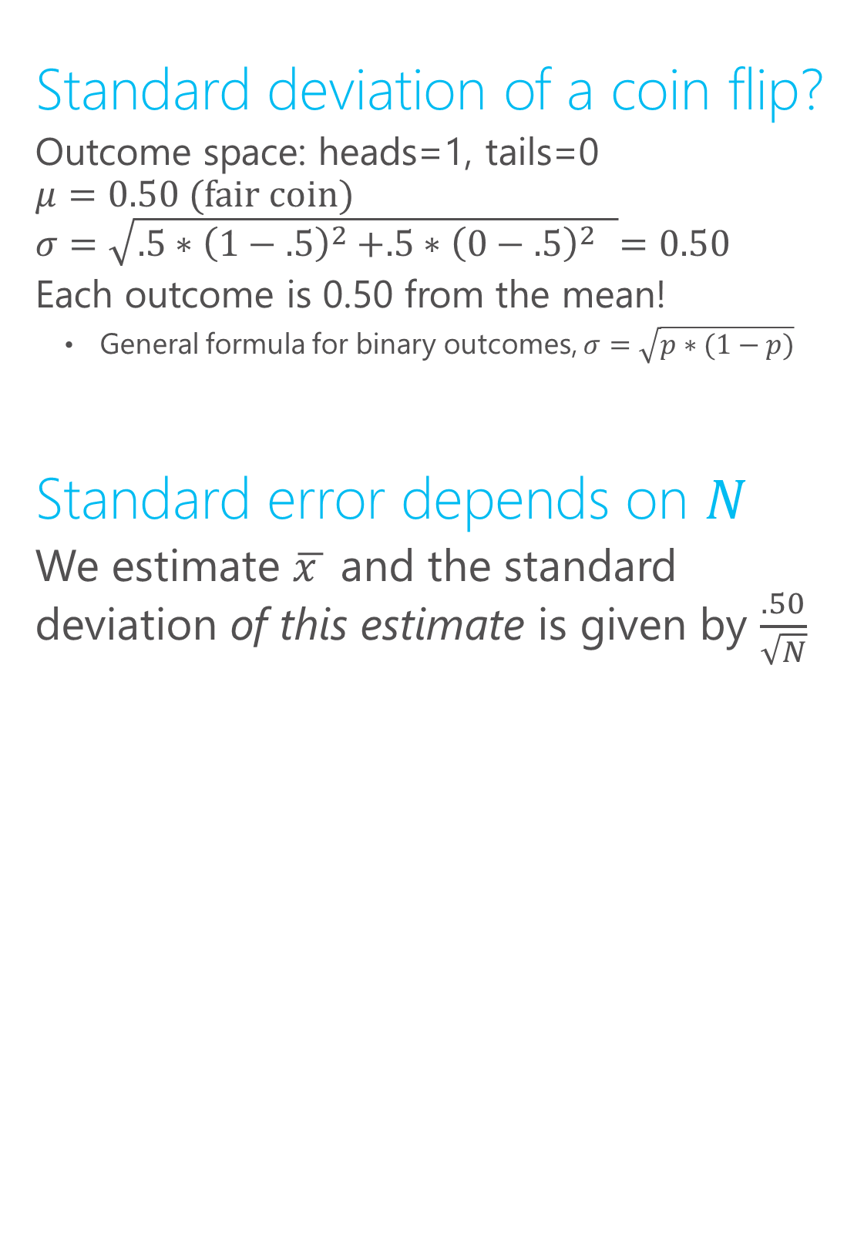
Coin flipping: s.e. vs. s.d.
Standard deviation of a coin flip?
Outcome space: heads=1, tails=0
$$μ=0.50 (\text{fair} \text{coin})$$
$$σ=\sqrt{.5{∗\left(1−.5\right)}^{2}+.5{∗{\left(0−.5\right)}^{2} }^{ }}=0.50$$
Each outcome is 0.50 from the mean!
General formula for binary outcomes, $σ=\sqrt{p∗(1−p)}$
Standard error depends on $N$
We estimate $\overline{x }$ and the standard deviation of this estimate is given by $\frac{.50}{\sqrt{N}}$

Slide 15

Standard error vs. standard deviation
Standard error measures the dispersion in the estimator (ex. sample mean) for a given sample size
The central limit theorem tells us how the variance in the population links up with the variance in our estimator: $\frac{σ}{\sqrt{N}}$
Ex. fair coin flip. Heads=1, Tails=0.
$μ$=0.5 $σ=0.5$
s.e. = 0.5/$\sqrt{N}$
$N$=4 → 0.25
$N$=25 → 0.1
$N$=100 → 0.05

Slide 16

Standard error and sample size
Ex. fair coin flip. Heads=1, Tails=0.
$μ$=0.5 $σ=0.25$
s.e. = 0.25/$\sqrt{N}$

Slide 17
Statistical uncertainty and $\sqrt{N}$
Ex. fair coin flip. Heads=1, Tails=0.
$μ$=0.5 $σ=0.25$
s.e. = 0.25/$\sqrt{N}$

Slide 18
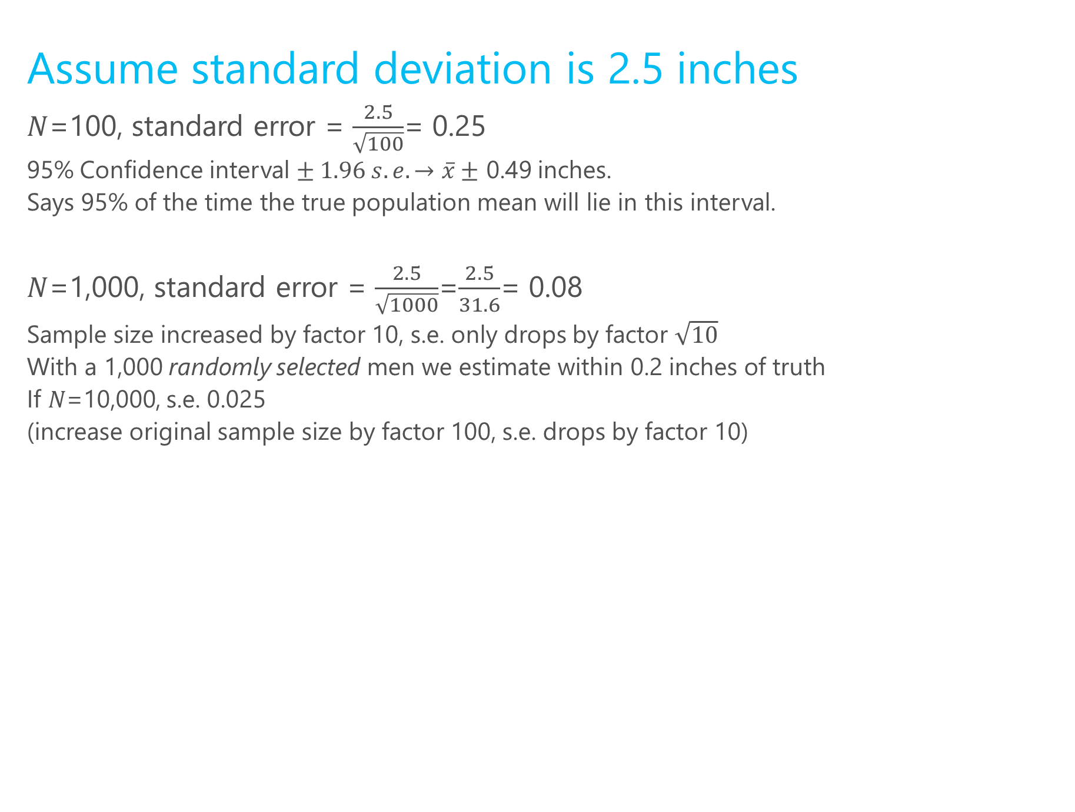
Height example cont.
Assume standard deviation is 2.5 inches
$N$=100, standard error = $\frac{2.5}{\sqrt{100}}$= 0.25
95% Confidence interval $± 1.96 s.e. →\overline{x}±$ 0.49 inches.
Says 95% of the time the true population mean will lie in this interval.
$N$=1,000, standard error = $\frac{2.5}{\sqrt{1000}}$=$\frac{2.5}{31.6}$= 0.08
Sample size increased by factor 10, s.e. only drops by factor $\sqrt{10}$
With a 1,000 randomly selected men we estimate within 0.2 inches of truth
If $N$=10,000, s.e. 0.025
(increase original sample size by factor 100, s.e. drops by factor 10)

Slide 19

Coin flipping: s.e. vs. s.d.
Central limit theorem says the distribution of the estimator will be Guassian for any population distribution with finite mean and variance
The underlying variables is 0-1, but the distribution of the sample mean is bell-shaped
As $N$ increases, the distribution will “collapse” to the true population mean (in this case 0.50)

Slide 20
Visualizing the CLT
N=4
Fair coin
http://blog.vctr.me/posts/central-limit-theorem.html

Slide 21
What does standard error capture?
Standard error captures how much our estimator will move around due the chance involved in sampling
This is known as sampling variation, it captures the degree to which small samples are different from the population.
It does not capture model uncertainty or bias in the sampling procedure
What if I have a non-random sample of U.S. males?
The “margin for error” you see on polls usually assumes they have a representative sample, and thus only reports sampling variation

Slide 22
Sampling and estimation
Sampling is the way we generate “observations”
I.e. it is the way we construct datasets
Any dataset that is not a “complete census” is a sample (and even a complete census only represents one point in time, so can be view as a sample too)

Slide 23
Returning to our example
Some samples:
Heights of the course instructors
Heights of all men in this room
All the men at MSFT
Men on 6th that will stop and talk to us
The samples are all biased, (3) will have the lowest s.e. but would not necessarily be closer to the truth

Slide 24
Random sampling for unbiasedness
s.e.’s are not very meaningful if the estimator is biased
Random sampling ensures that the sample mean will equal the population mean in expectation
Bias is often more important than sampling variation!

Slide 25
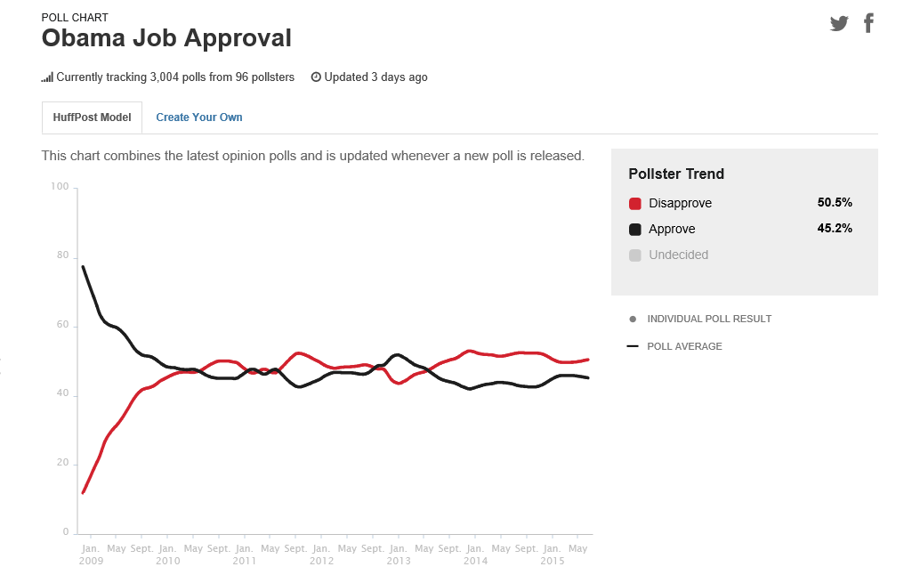
Example: polls

Slide 26
Example: polls

Slide 27
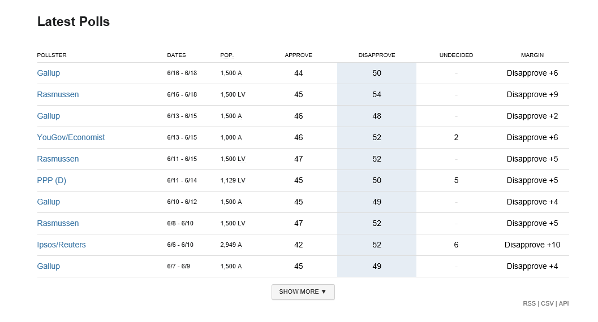
Why do these numbers differ?

Slide 28
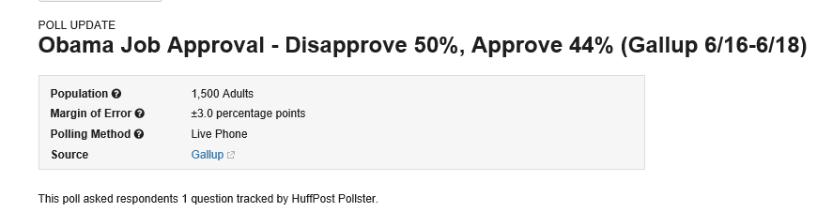
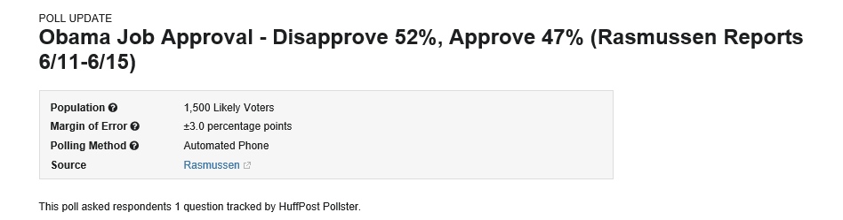


Slide 29

Two key properties of an estimator
Bias: if $E\left[\hat{β}\right]=β$ then the estimator is said to be unbiased. “with a very large sample we expect to uncover the truth”
Variance: the degree to which the estimator jumps around
In more complicated settings, different estimators of the same underlying quantity can have different s.e.’s

Slide 30
Returning to the height example
A fully random sample of 25 U.S. men will be unbiased but have relatively high variance
A large sample of all MSFT male employees will have a very low variance, but is likely biased

Slide 31
What determines properties of an estimator?
The estimation method itself
The sample mean is an estimator that is unbiased if the sampling is done correctly
Other more complicated estimators have different properties, we will see this in later lectures
How the sample was drawn
Even “good estimators” are lousy with poor samples.

Slide 32

Hypothesis testing
$$H_{o}:null hypothesis −→population parameter=μ_{0}$$
$$t=\frac{\overline{x}−μ_{0}}{s/\sqrt{N}}$$
$s$=sample standard deviation
$\overline{x}$=sample mean or anything that “behaves like a sample mean”

Slide 33

Hypothesis testing
$$H_{o}:null hypothesis −→population parameter=μ_{0}$$
$$t=\frac{\overline{x}−μ_{0}}{s/\sqrt{N}}$$
p-value: probability we observe an $\overline{x}−μ_{0}$ difference due to chance (driven by sampling)

Slide 34
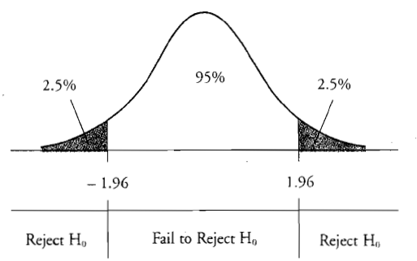

Hypothesis testing
$$H_{o}:null hypothesis −→population parameter=μ_{0}$$
$$t=\frac{\overline{x}−μ_{0}}{s/\sqrt{N}}$$

Slide 35
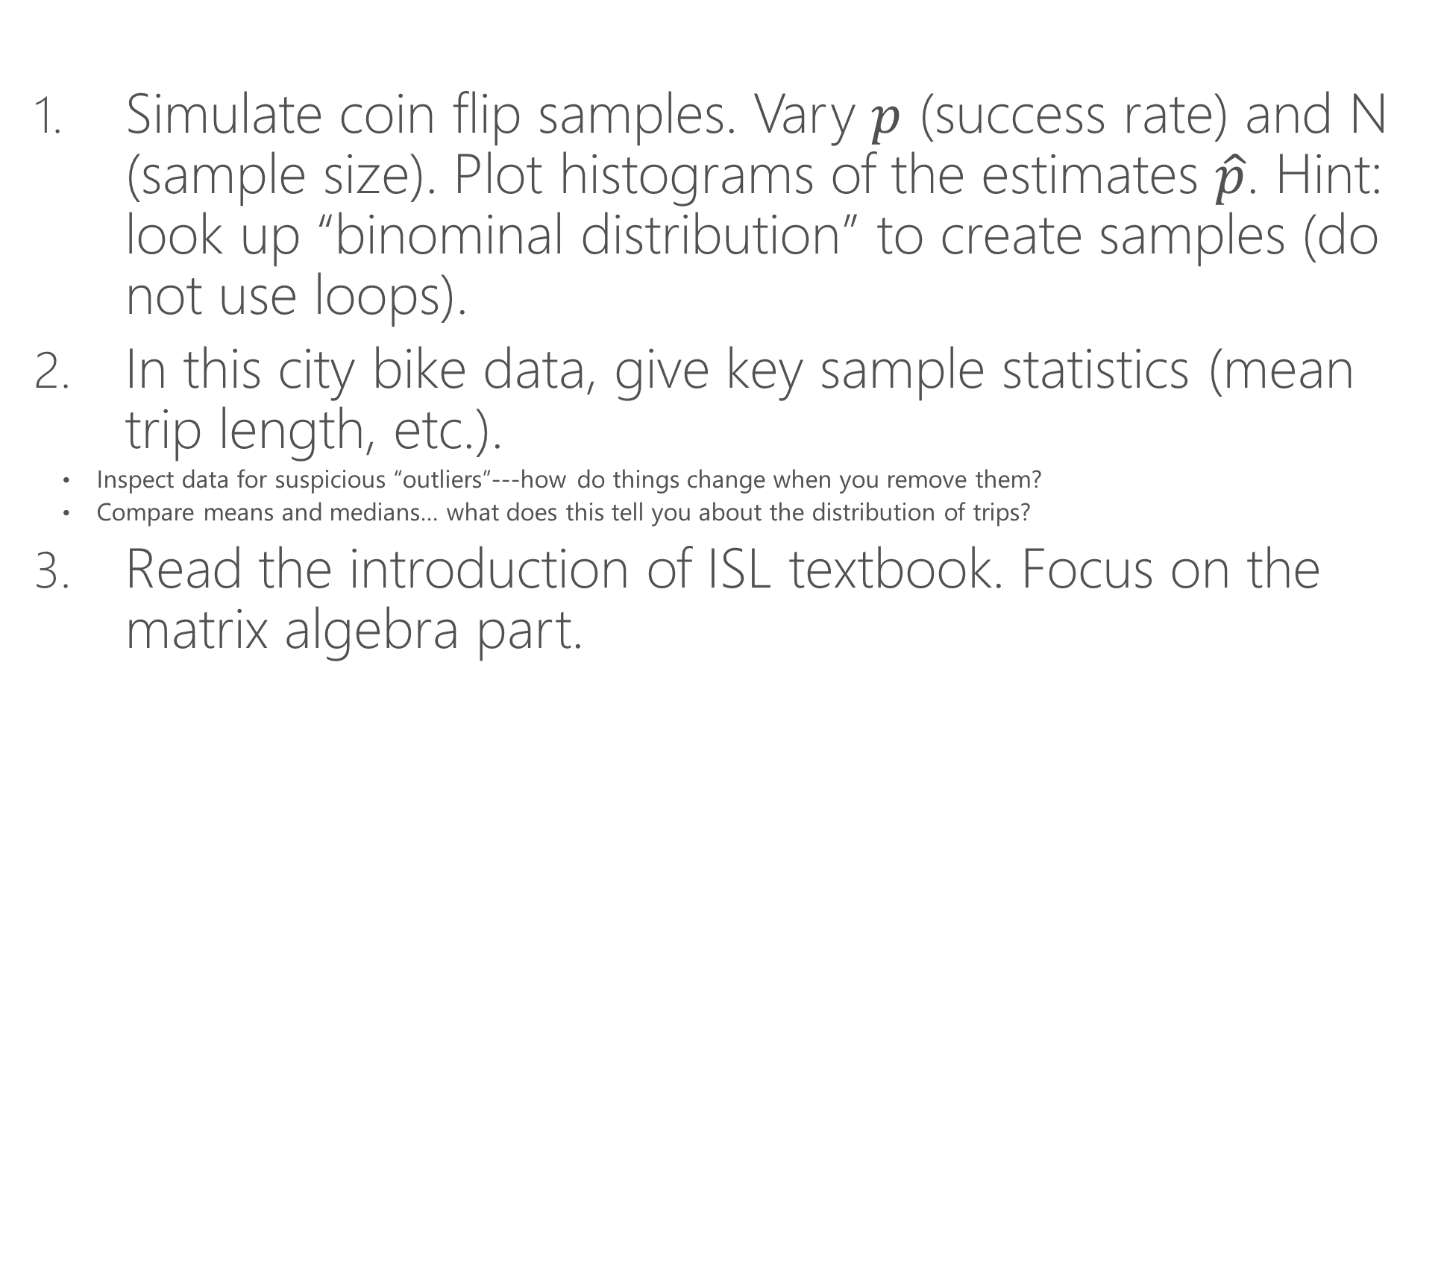
Assignments
Simulate coin flip samples. Vary $p$ (success rate) and N (sample size). Plot histograms of the estimates $\hat{p}$. Hint: look up “binominal distribution” to create samples (do not use loops).
In this city bike data, give key sample statistics (mean trip length, etc.).
Inspect data for suspicious “outliers”---how do things change when you remove them?
Compare means and medians… what does this tell you about the distribution of trips?
Read the introduction of ISL textbook. Focus on the matrix algebra part.

